Slide 1
筆譯畢專注意事項

Slide 2
Basic Criteria
Translate an book that has never been translated into Chinese.
Each person must translate a minimum of 4000 words.
Print the translated work and the original into a book form and put on an exhibit.

Slide 3
Group or Individual Work
Group leader translates only 3000 words and each member translates 4000.
Group leader takes on the role of project manager, setting deadlines, delegating works, and solving problems.
One-person group must complete 4000 words and handle exhibition work.

Slide 4
How to Choose a Book
No cookbooks. Books on food, yes.
No children’s literature. Too easy!
Don’t insist on one particular book.
Every team member must pitch in.
Get approval from your advisor.
Think of how to present it in the exhibit.

Slide 5
Do I Have to Translate the Entire Book?
NO!
There is obligation to translate the entire book.

Slide 6
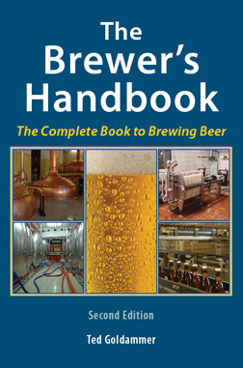
Examples

Slide 7
Where to find books
Gutenburg Project
Pro: No copyright
Con: Older books. More awkward diction and usage.
2. Online book store.
3. Eslite or Caves Books

Slide 8
Do I Really Need Authorization?
$ Yes!
$ Find an example of the letter on the dept. website.
$ Check publisher’s website to find where and to whom to send the letter.

Slide 9
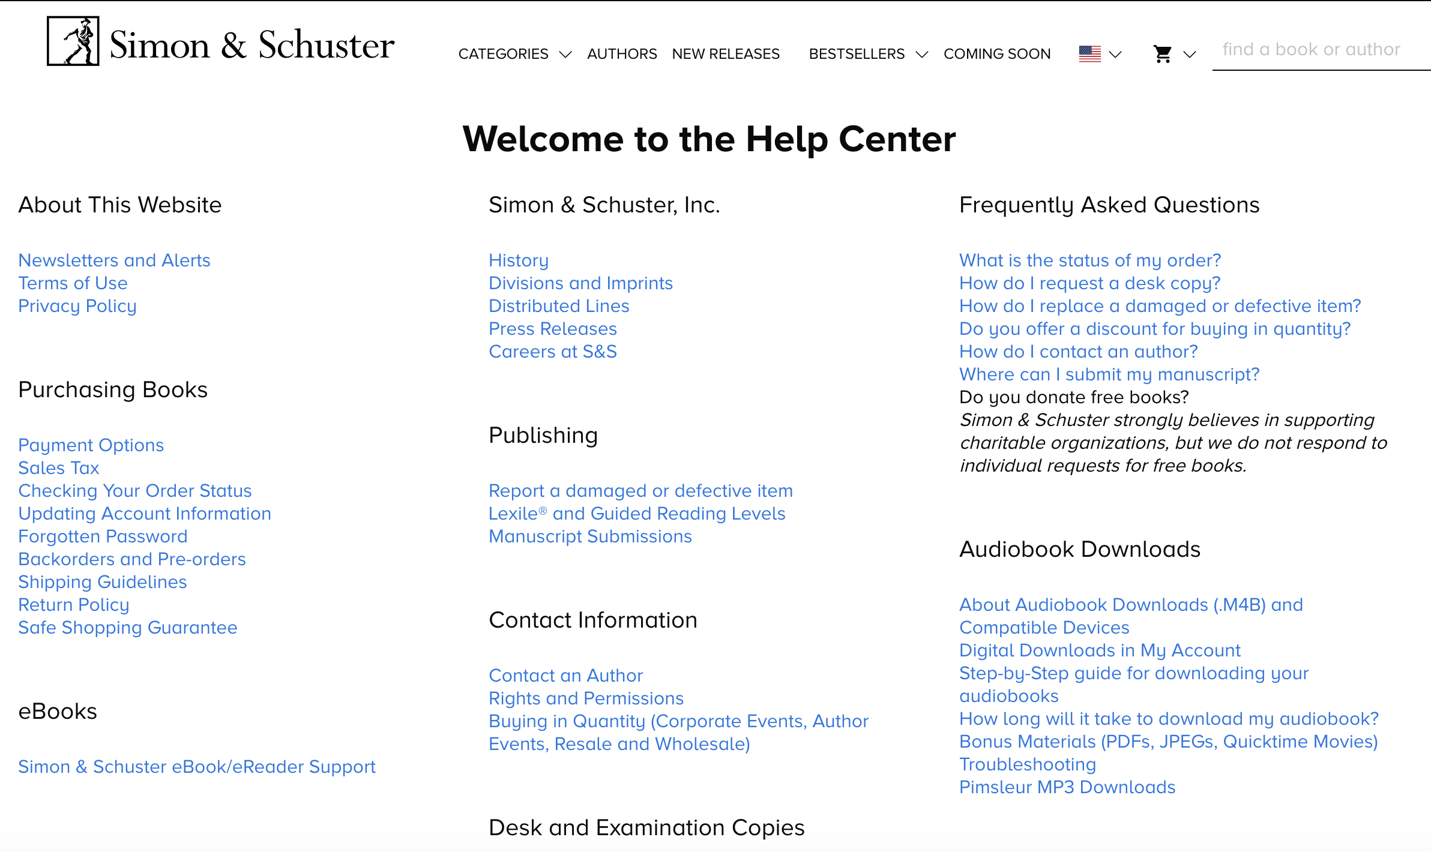
For example

Slide 10
Timeline
You decide as a team.
Remember, drafts are due at the beginning of next term.
Set up time to discuss as a group.
All drafts should be turned in by 14th week during the first semester.

Slide 11
Terminologies and Editorial Decisions
You must all decide as a group, such as font types and book size.
Suggestion: Set up a Google docs file so everyone knows how everyone else translates a particular name or noun
Forwards and other things optional

Slide 12
Remember
The teachers are GRADING your drafts, not proofreading them.
Make sure CONSISTENCY in proper nouns and terminologies.
It would be nice if the tone and style are similar throughout the book.
Plan how to present your book at the exhibition early.

Slide 13
Exhibition and Symposium
Around end of March or early April, the translation groups will hold an exhibition of their books.
On the opening day, you will have a symposium discussing:
$ How you chose the book
$ What the book is about
$ Your translation process and how you solved problems.

Slide 14
分組表

